Slide 1
Weight, Mass, Volume and Density

Slide 2
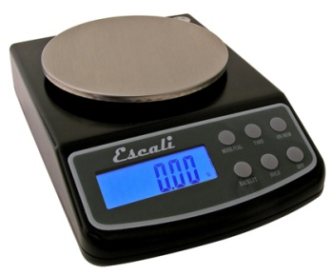
What is Weight?
Weight is a measure of the force of gravity on an object
On Earth, all objects are attracted towards the center of the planet by the force of Earth’s gravity
On other planets, the force of gravity on you may be more or less than it is on Earth
On the Moon, you would weigh less than you would on Earth – only about 1/6th of your weight on Earth

Slide 3
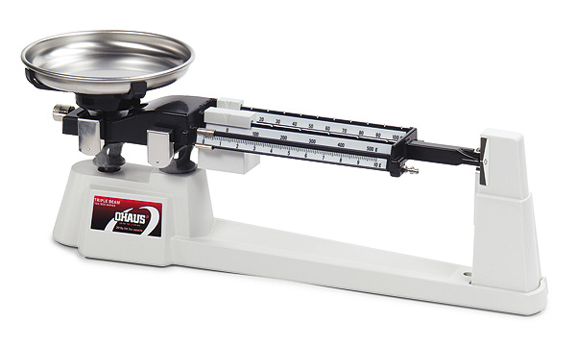
What is Mass?
The force of gravity depends partly on the mass of an object
The mass of an object is the measurement of the amount of matter in the object

Slide 4
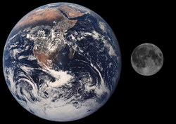
Why do you weigh less on the moon?
If you travel to the moon, your mass does not change
The mass of the moon is much less than the mass of Earth
Therefore the moon will exert much less gravitational force on you

Slide 5
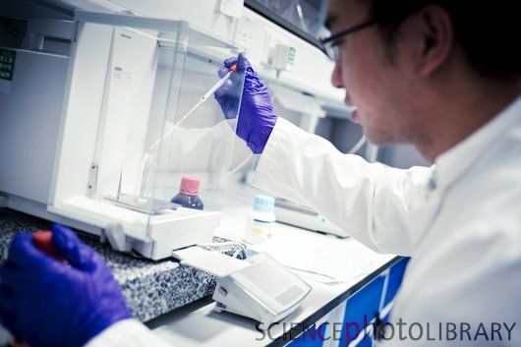
Why do scientists prefer to measure matter by mass instead of weight?
Unlike weight, mass does not change with location
Even when the force of gravity on an object changes mass will not change
For this reason, scientists prefer to measure matter by mass instead of weight

Slide 6
What units do scientists use to measure mass?
The mass of an object is a physical property
To measure the properties of matter scientists use the International System of Units, abbreviated SI
The SI unit of mass is the kilogram (kg)
If you weigh 90 pounds on Earth, your mass is about 40 kilograms

Slide 7
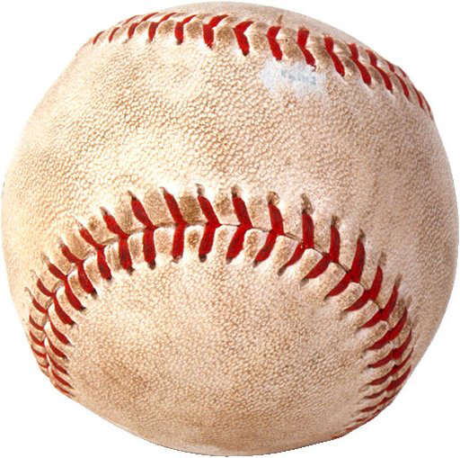
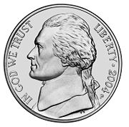
What is another commonly used unit for mass?
The gram (g) is another commonly used unit for mass
There are exactly 1,000 grams in a kilogram, so a gram is much smaller than a kilogram
Examples of the mass of some everyday items are:
a nickel has a mass of 5 grams
a baseball has a mass of 150 grams

Slide 8
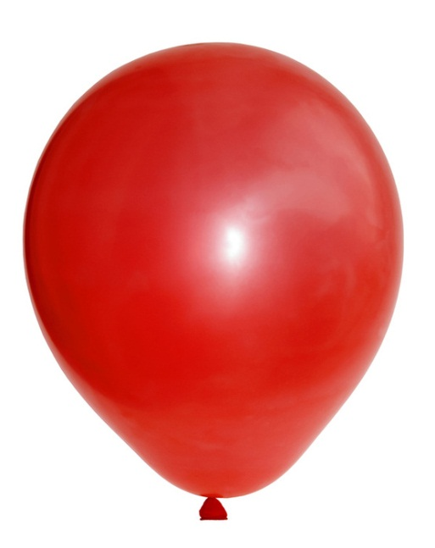
What is volume?
All matter has mass and takes up space
The amount of space that matter occupies is its volume
Solids, liquids and gases all have volume
Example – When you blow up a balloon you are increasing the volume of gas in the balloon with your breath

Slide 9
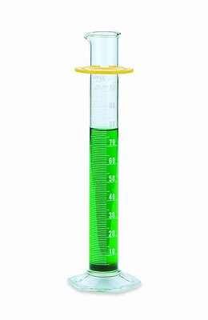
What are the common units of volume?
The common units of volume include the liter (L), milliliter (mL), and cubic centimeter (cm³)
Volumes smaller than a liter are given in milliliters
A milliliter is one-thousandth (0.001) of a liter
A milliliter (1 mL) is exactly the same volume as one cubic centimeter (1 cm³)
In the lab, volumes of liquid are measured with a graduated cylinder

Slide 10
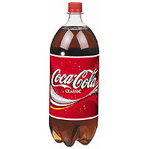
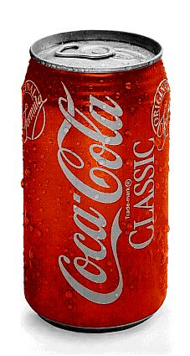
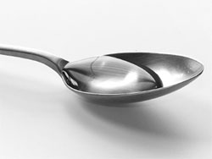
What is the volume of some everyday items?
Some plastic soda bottles hold 1 liter of liquid
A teaspoon full of water has a volume of about 5 mL
A can of soda contain 355 mL of liquid

Slide 11
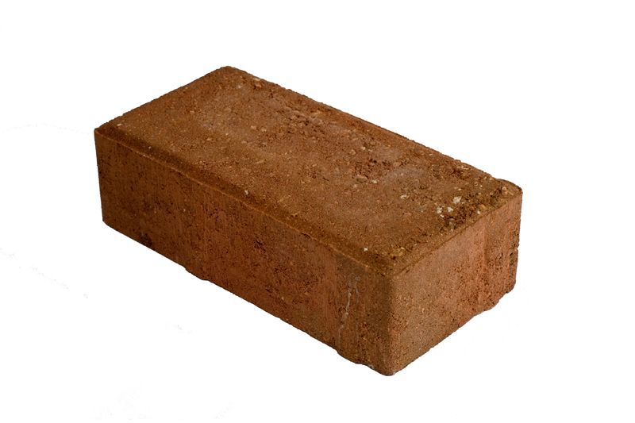
How do you calculate the volume of a solid rectangular object?
The volumes of solid objects are usually expressed in cm³
If you want to know the volume of a rectangular object, such as a brick, you need to measure the object’s length, width, and height, then, you multiply these values

Slide 12
Calculating Volume of a solid rectangular object
Volume = Length x Width x Height
Measurements always have units, so when you multiply the 3 measurements, you must multiply the units as well as the numbers
Units = cm x cm x cm = cm³
Height
Width
Length

Slide 13
How can you measure the volume of an irregularly shaped object?
The most commonly used way to measure the volume of an irregularly shaped object, such as a rock, is to use the water displacement method
First you fill up a graduated cylinder with a level of water that will cover the object
Then you drop the irregularly shaped object into the graduated cylinder of water and observe how much higher the water level becomes

Slide 14
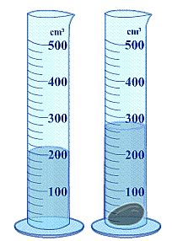
How can you measure the volume of an irregularly shaped object?
The volume of the object would be the difference between the volume of the object in the water from the volume of just the water
Subtracting these two volumes will give you the volume of an irregularly shaped object

Slide 15
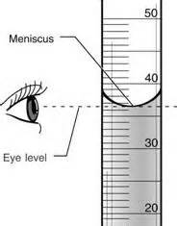
Reading a graduated cylinder
The way to read the volume when using a graduated cylinder is to see where the lowest part of the meniscus is on the scale.
The meniscus is the curve of the surface of the liquid in the graduated cylinder. The surface is not flat, it's lower in the middle. This is due to surface tension, that pulls the water up the walls of the cylinder.

Slide 16
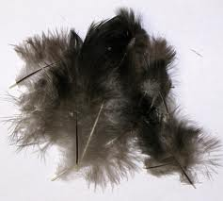
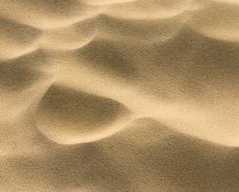
What is density?
Samples of 2 different materials may have the same volume but they might not have the same mass
For example, 1 kg of sand takes up much less space than 1 kg of feathers
The volumes differ because sand and feathers have different densities
Density relates the mass of a material in a given volume

Slide 17
How do you calculate density?
Example: A sample of liquid has a mass of 24g and a volume of 16 mL. What is the density of the liquid?
Given: Mass of liquid = 24g
Volume of liquid = 16 mL
Mass
24g
Density =
=
= 1.5 g/mL
Volume
16mL

Slide 18
How is density expressed?
Density is expressed as the number of grams in one cubic centimeter
For example, the density of water at room temperature is stated as “one gram per cubic centimeter (1g/cm³)
You can determine the density of a sample of matter by dividing its mass by its volume
Mass
Density =
Volume

Slide 19
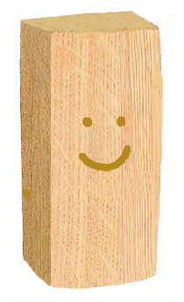
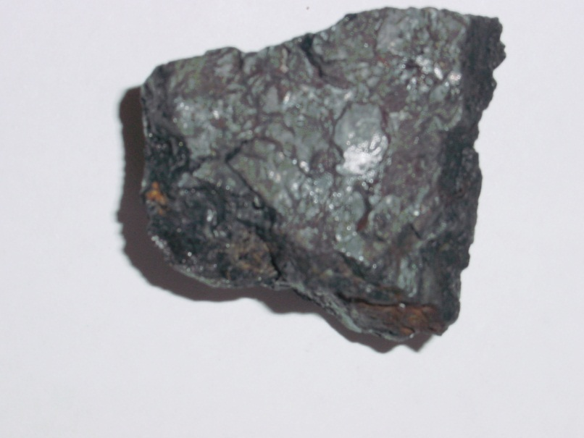
How do we use density?
Whether or not an object sinks or floats depends on its density
For example, if we drop a solid block of wood and a solid block of iron into a tub of water, we would see that the wood would float while the iron would sink

Slide 20
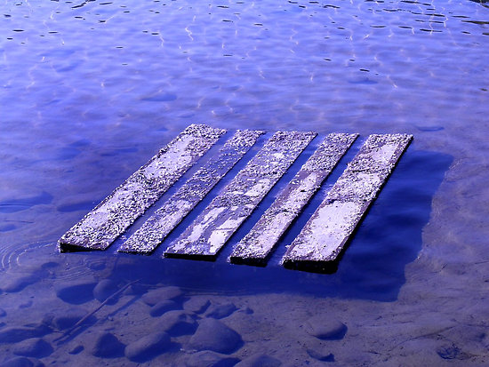
How do we use density?
Since the density of water is 1g/cm³ , any object that is greater than the density of water, such as iron, will sink
Any object that is less than the density of water, such as wood, will float
Density is a physical property of a substance that can be used to identify an unknown substance

